Slide 1
Amphibian Presence Prediction
Jerry Ngo

Slide 2
Intro
Based on satellite information on amphibian appearance, give prediction on the occurrence of amphibian based on the site’s attribute.
Applying model like decision tree, support vector machine, artificial neural network and ensemble learning methods like stacking and boosting on the data set.

Slide 3
Data Set

Slide 4
Data Set Information
Was prepared for the environmental impact assessment reports for two planned road in Poland.
Gives the amphibian population with 189 occurence sites along with 16 attributes of each site.
7 amphibian species

Slide 5
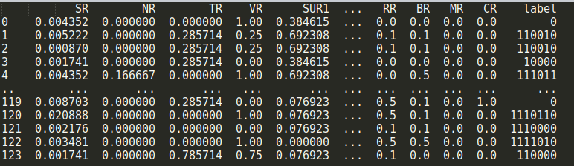
Data Set Preprocess
Data is well collected and presented
Select attribute for training
Concatenate label
Split training and validation set

Slide 6
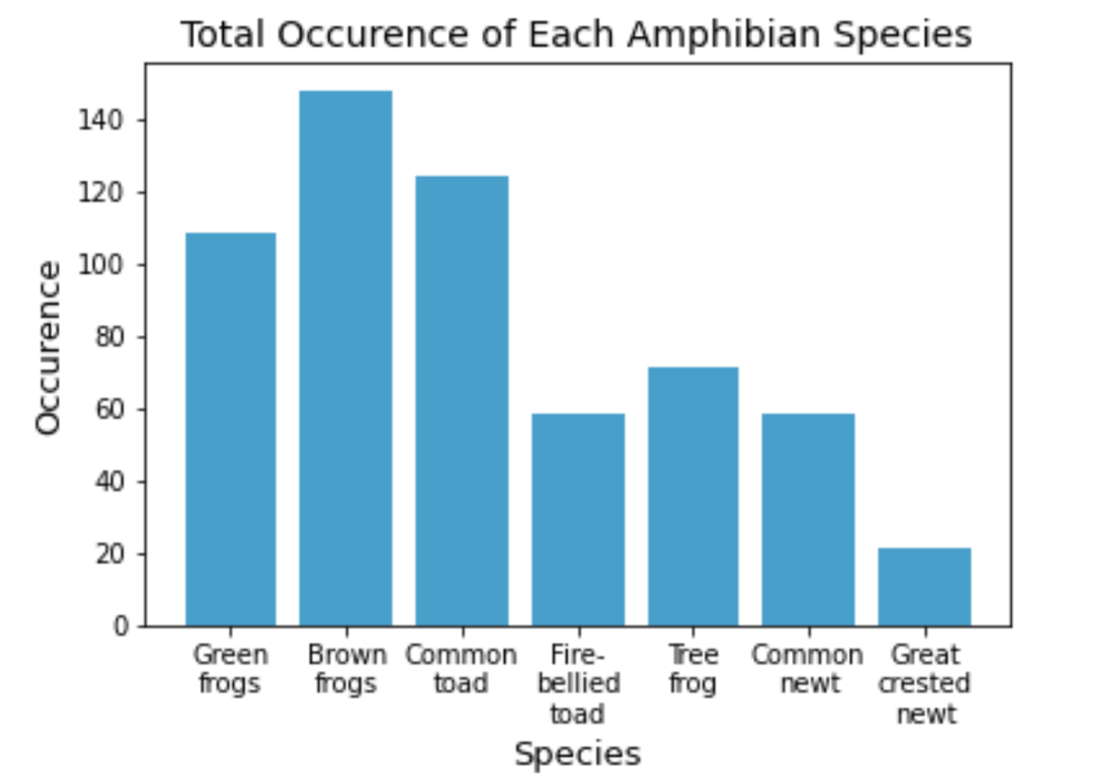
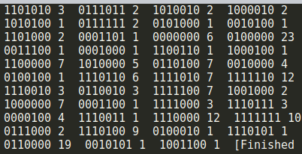
Data Set Analyzation
Distribution is not evenly distributed

Slide 7
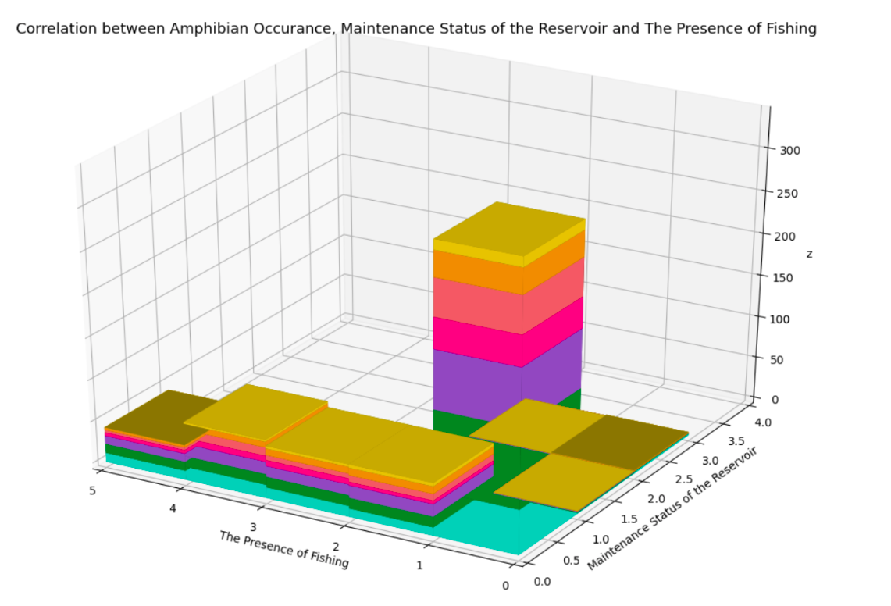
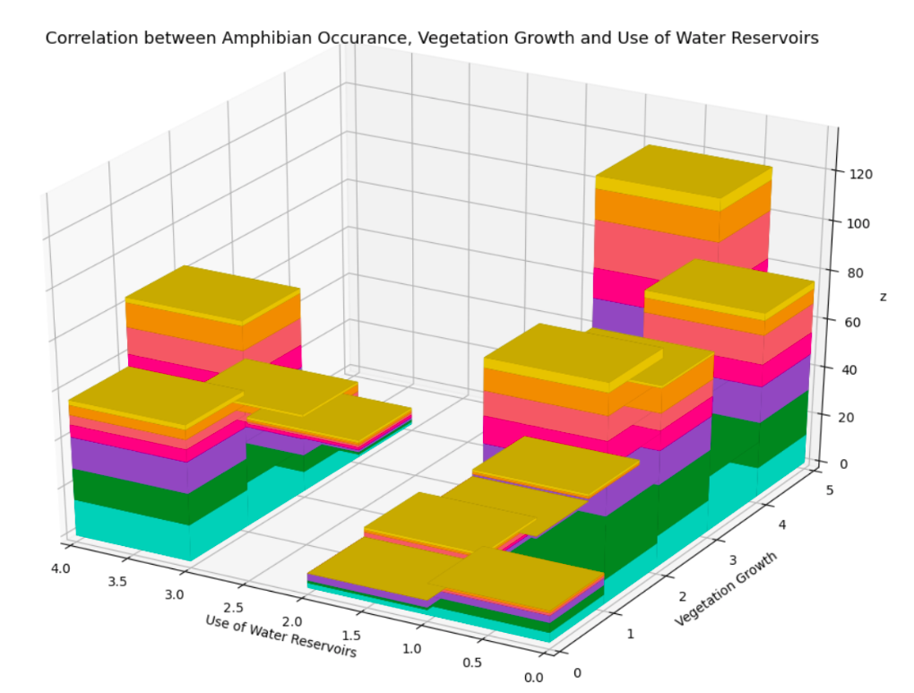
Data Set Analyzation
No attributes that can be used to easily predict the species occurrence

Slide 8
Machine Learning Model

Slide 9
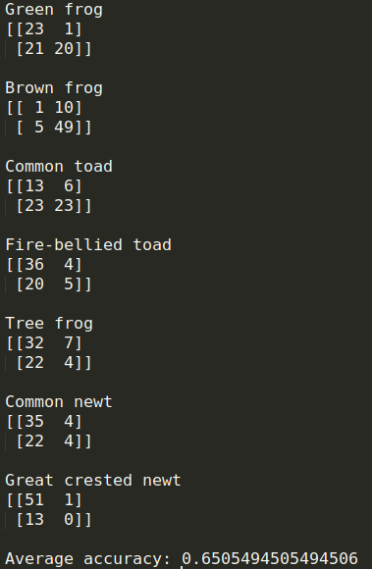
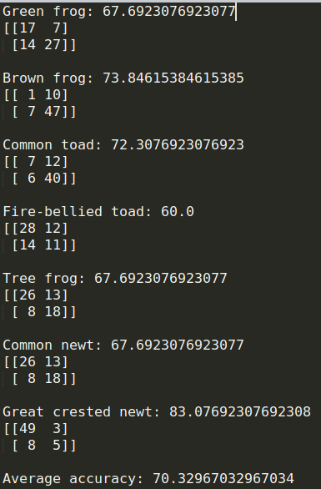
Support Vector Machine
Tune the punishment of soft margin, kernel (poly, RBF), the degree of the poly kernel and balanced the class weight for imbalance species of each SVM
Accuracy: 70.33%
Old
New

Slide 10
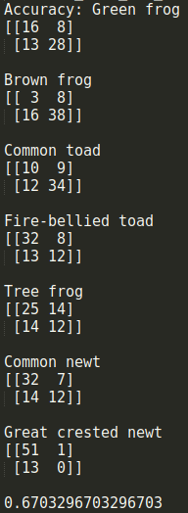
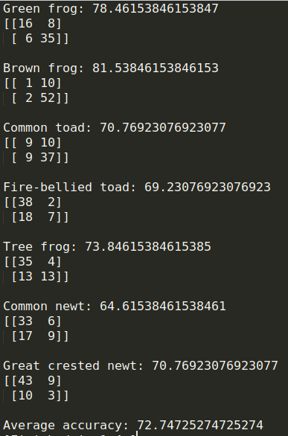
Artificial Neural Network
Tune the number and the size of hidden layer for each ANN
lbfgs for activation
Limited-memory BFGS solver for weight optimization
Accuracy: 72.75%
Old
New

Slide 11
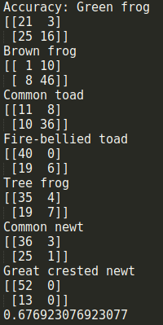
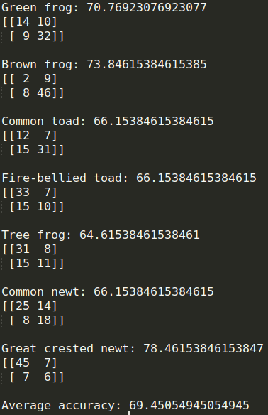
Decision Tree
Tune splitting criteria, maximum tree depth, number of features to consider when looking for the best split and whether it uses should balance the class weight for each Decision Tree
Accuracy: 69.45%
Old
New

Slide 12
SVM
ANN
Decision Tree

Slide 13
Ensemble Models

Slide 14
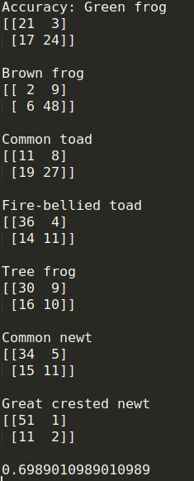
Random Forest
Set the max depth of 4
Learning rate: 0.72
Random state of 6
Accuracy: 69.9%

Slide 15
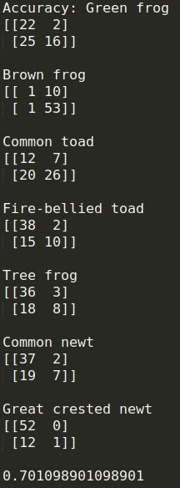
AdaBoost
Use the previous decision tree classifier for the base classifier
Learning rate: 0.72
Random state of 5
Accuracy: 70.1% with validation set

Slide 16
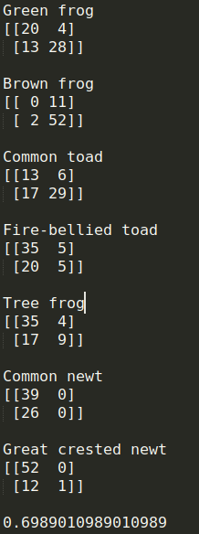
Stacking using Bayes Optimal Classifier
Use 6-fold to choose the best training set to train the Bayes classifer using the base learners (SVM, Decision Tree, ANN)
Use Gaussian Naive Bayes as meta classifier
Accuracy: 69.9%

Slide 17
Random Forest
Adaboost
Stacking using Bayes

Slide 18
Classifier | Accuracy
SVM | 70.33%
KNN | 64.6%
ANN | 72.75%
Decision Tree | 69.45%
Random Forest | 69.9%
Bayes Stacking | 69.9%
AdaBoost | 70.1%
Overall ANN has the best performance of 72.75%
Because of the uneven distribution and a really small instance, it is hard to get a better accuracy

Slide 19

Thanks!
Phuc Ngo, Beloit College
ngoph@beloit.com

